Slide 1
Census Sermon
By Zahra Roach

Slide 2


Slide 3
Tacoma Refugee Choir
https://youtu.be/olYJjvdj6L0

Slide 4
Hard To Count Communities
Children 5 years of age or younger
People living in poverty
People experiencing homelessness
African Americans
Latinos
Asian American, Native Hawaiians, and Pacific Islanders
Immigrant Communities
Religious minorities

Slide 5

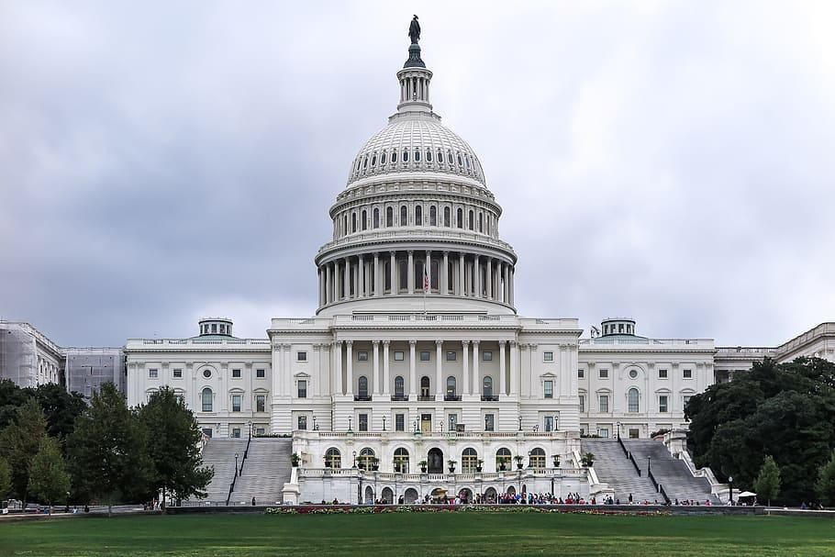
What is at stake?
Each person that is not counted = $2,300 lost in funding every year, for the next 10 years
Since our area will exceed 300,000 people, we could miss out on

Slide 6
Federal Programs That Rely on Census Data
Highway planning and construction
Public transit grants
FEMA emergency support
Unemployment insurance
Substance abuse prevention and treatment
Early Head Start
programs
state children’s health insurance.
Special Education grants
Medicaid & Medicare (part b)
Section 8 housing
Temporary Assistance for Needy Families
WIC and Supplemental Nutrition Assistance Programs
School breakfast and lunch

Slide 7
Litany on Dignity and Justice
Reader: Divine Creator, you tell us that we are made in your image. We believe that all people, regardless of race, religion, or immigration status have inherent dignity because you made us. Our inherent dignity demands recognition.
All: We will celebrate our dignity and we will count ourselves!
Reader: We know you long for the freedom of all people and for chains of oppression to break. For far too long, too many of your children have been excluded and counted as less than human, which has resulted in inequality and injustice. But we know you count each of us as equal in your eyes.

Slide 8
Litany on Dignity and Justice
All: Just as you count us, we will count ourselves!
Reader: You’ve commanded us to love our neighbor as ourselves. When we count ourselves, we are helping make sure not only our needs are met, but also that our neighbors have good schools, hospitals, roads, critical resources, and fair political representation.
All: For our neighbors, we will count ourselves!

Slide 9
Litany on Dignity and Justice
Reader: Divine Creator, you assure us to ‘fear not.’ You walk with us in our lives and we trust in your spirit and guidance. We proclaim ourselves as your children and our dignified presence in this nation.
All: We declare our presence and we will count ourselves!

Slide 10

Call to Action
Complete your Census
Call 10 friends
Write a letter to the editor, post on social media,

